Slide 2
Storage - Secure File and Image Hosting with Amazon S3
Name
Title
Company

Slide 3
Agenda
Storage overview & options
Working with Files
Controlling File Access
Lambda Triggers
Demo

Slide 4

AWS Amplify Workflow
Create Storage via the CLI
Connect & interact with Storage via the client libraries
Update, remove, and add additional services via the CLI

Slide 5
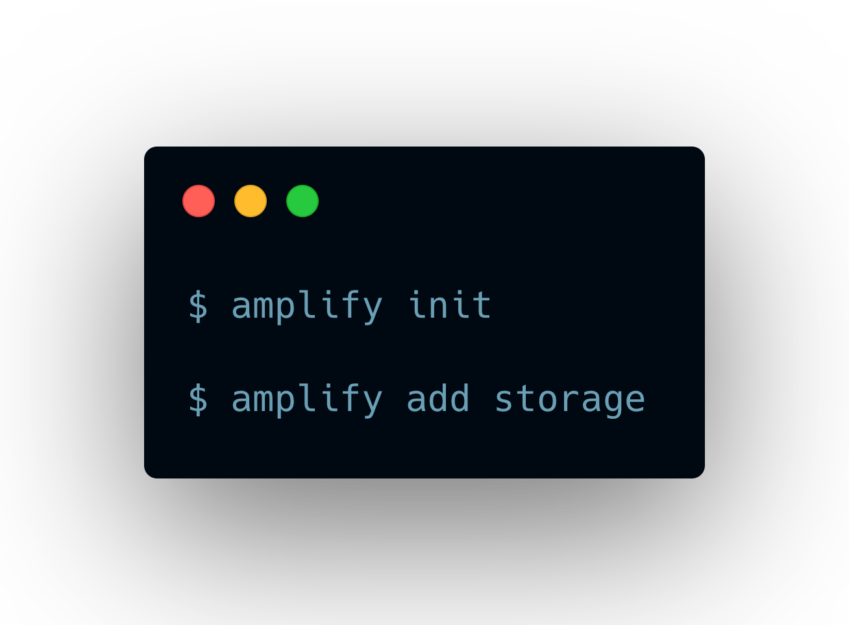
AWS Amplify CLI
Storage - initialization

Slide 6
AWS Amplify CLI
Storage - initialization
Amazon S3 - files, image, videos
Amazon DynamoDB – NoSQL database

Slide 7
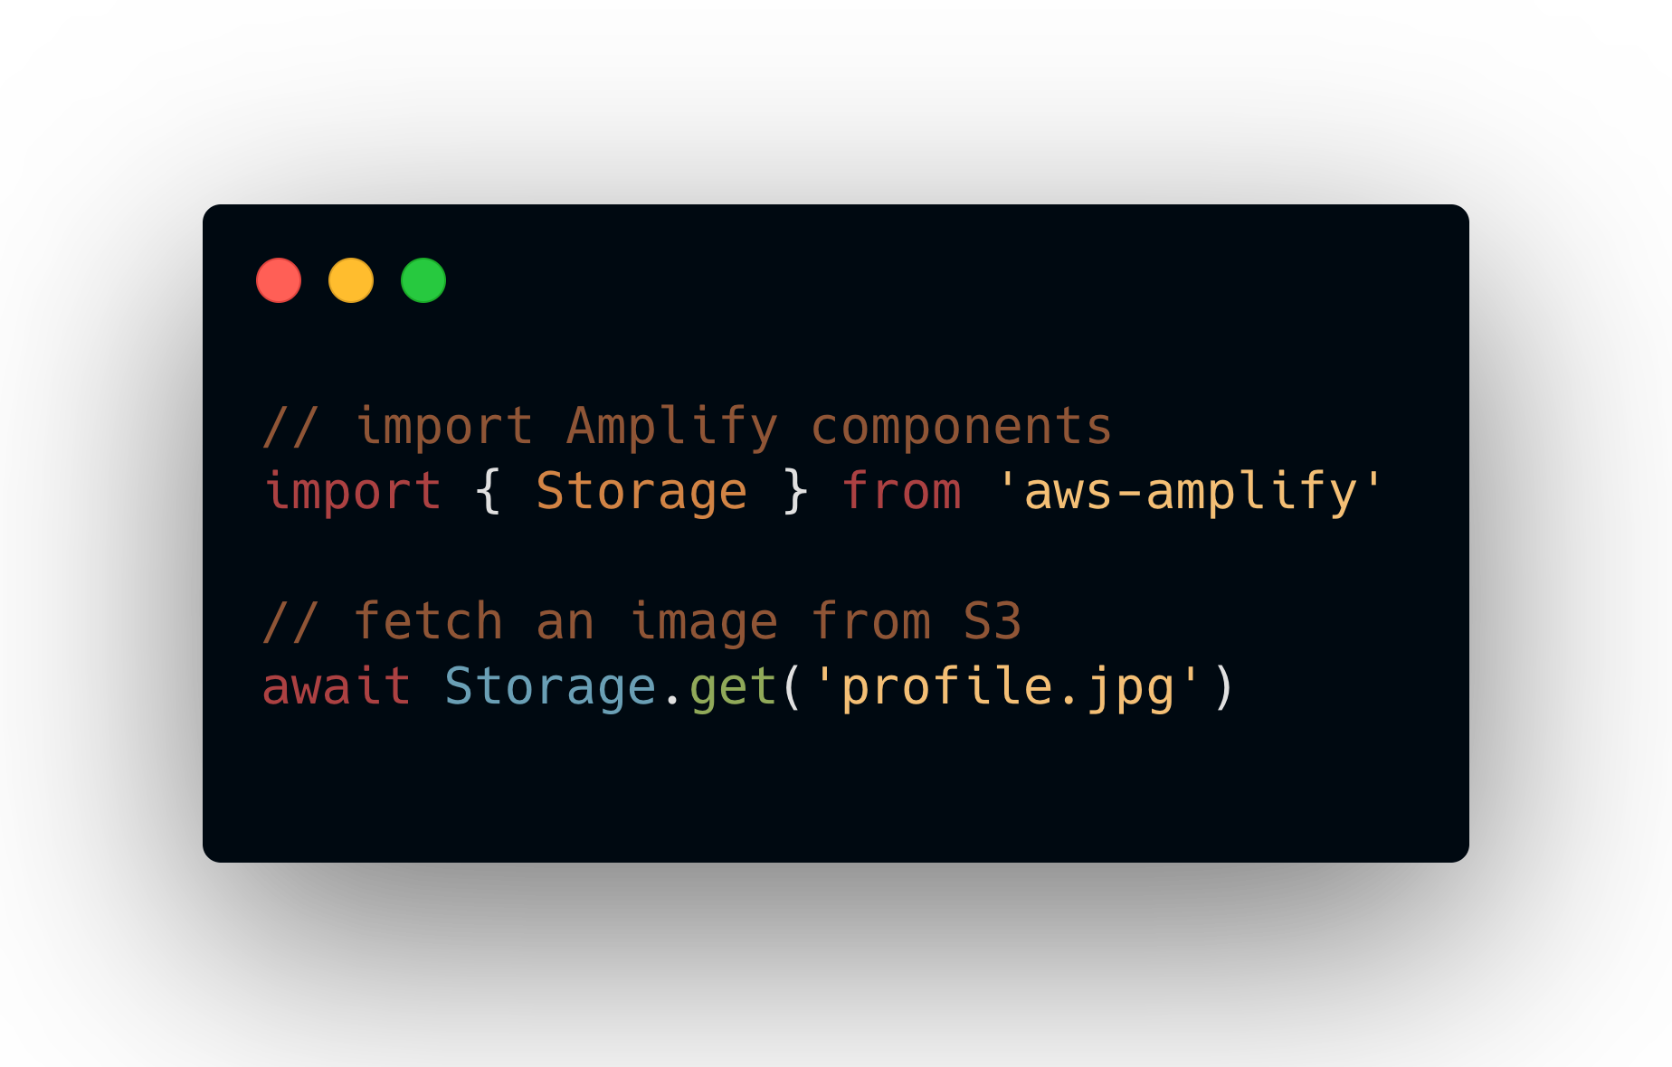
AWS Amplify Client
Storage - Usage

Slide 8
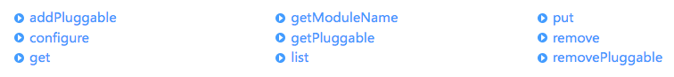
AWS Amplify Client
Storage class

Slide 9
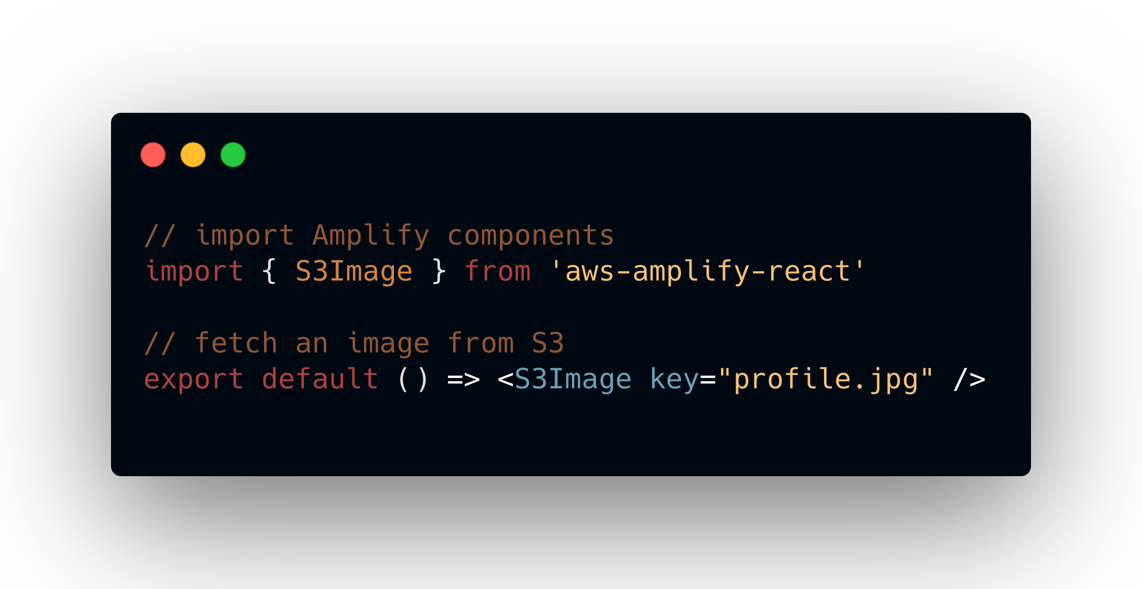
Amplify Framework Components
S3Image - Usage

Slide 10
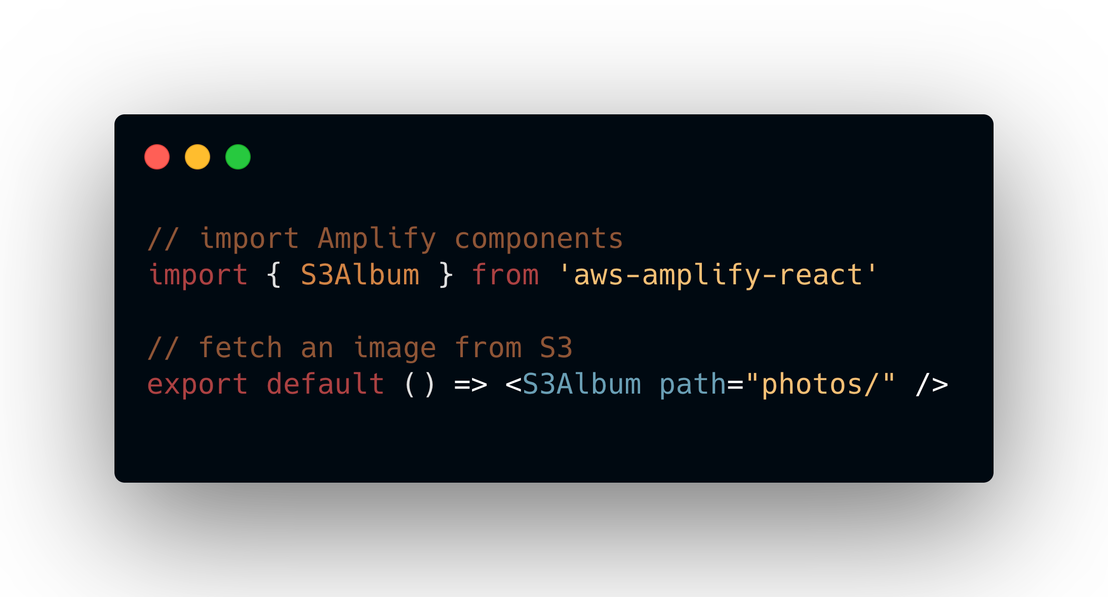
Amplify Framework Components
S3Album - Usage

Slide 11
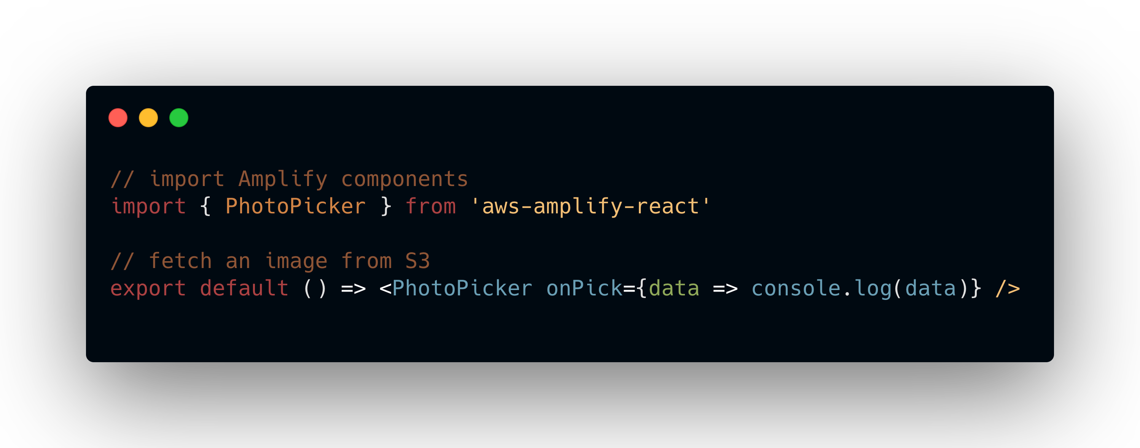
Amplify Framework Components
Picker - Usage

Slide 12
Storage Overview & Options

Slide 13
Storage – Amazon S3
Setup
Requires Cognito (auth)
Use a unique bucket name (global to AWS account)
Allow only authenticated users or allow guest users as well
Set CRUD permissions for bucket (create/update, read, delete)
Add a Lambda trigger to the bucket

Slide 14
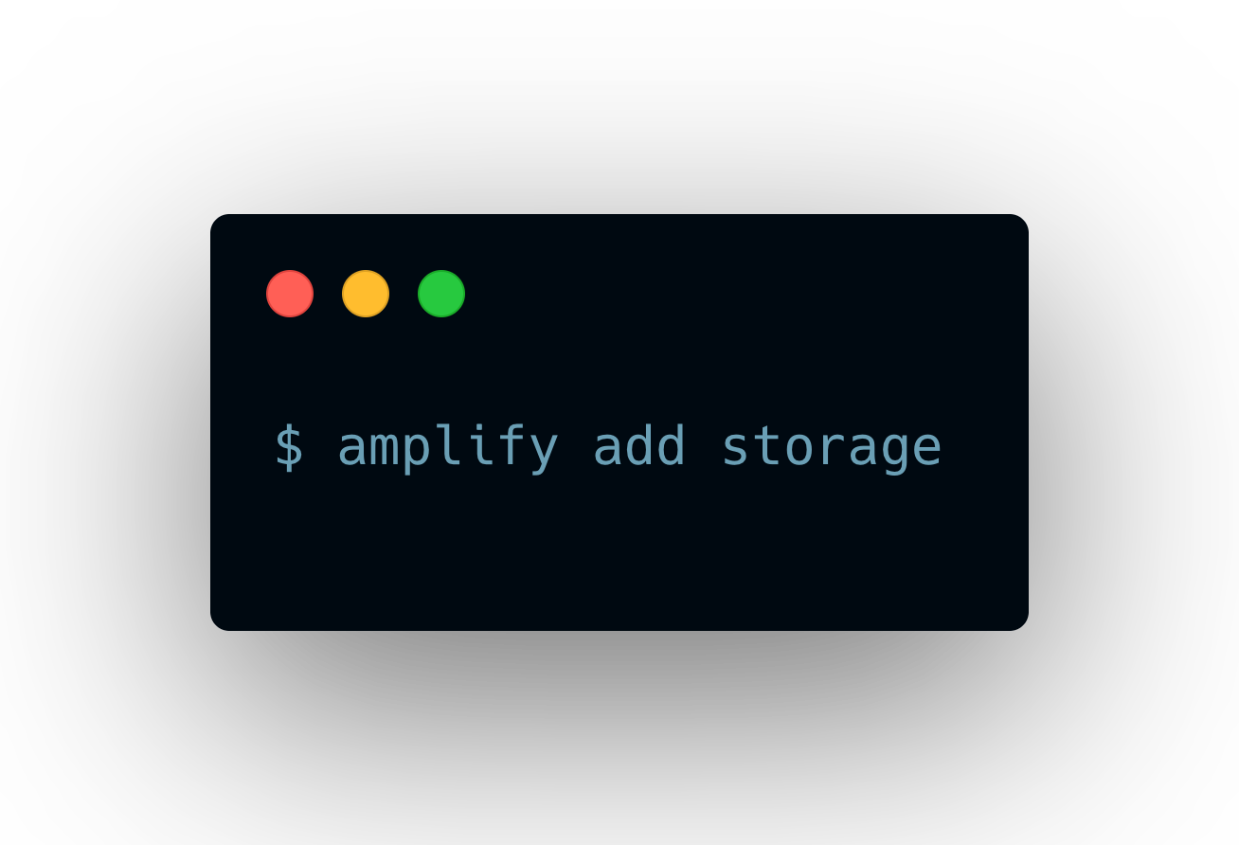
Amplify CLI
Adding storage

Slide 15
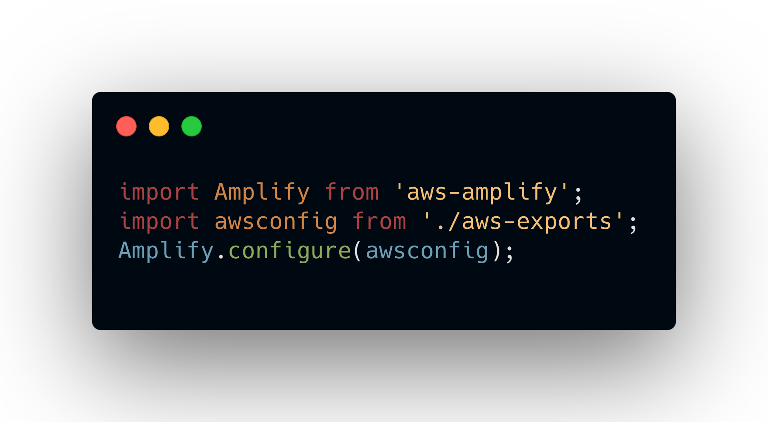
Amplify Client
Configuring Amplify

Slide 16
Working with Files

Slide 17
Storage
CRUD Operations
Storage.put – upload a file to S3 at a given path
Storage.get – get a signed URL to the file at a given path
Storage.delete – delete a file at a given path
Storage.list – list all files at a given path or folder

Slide 18
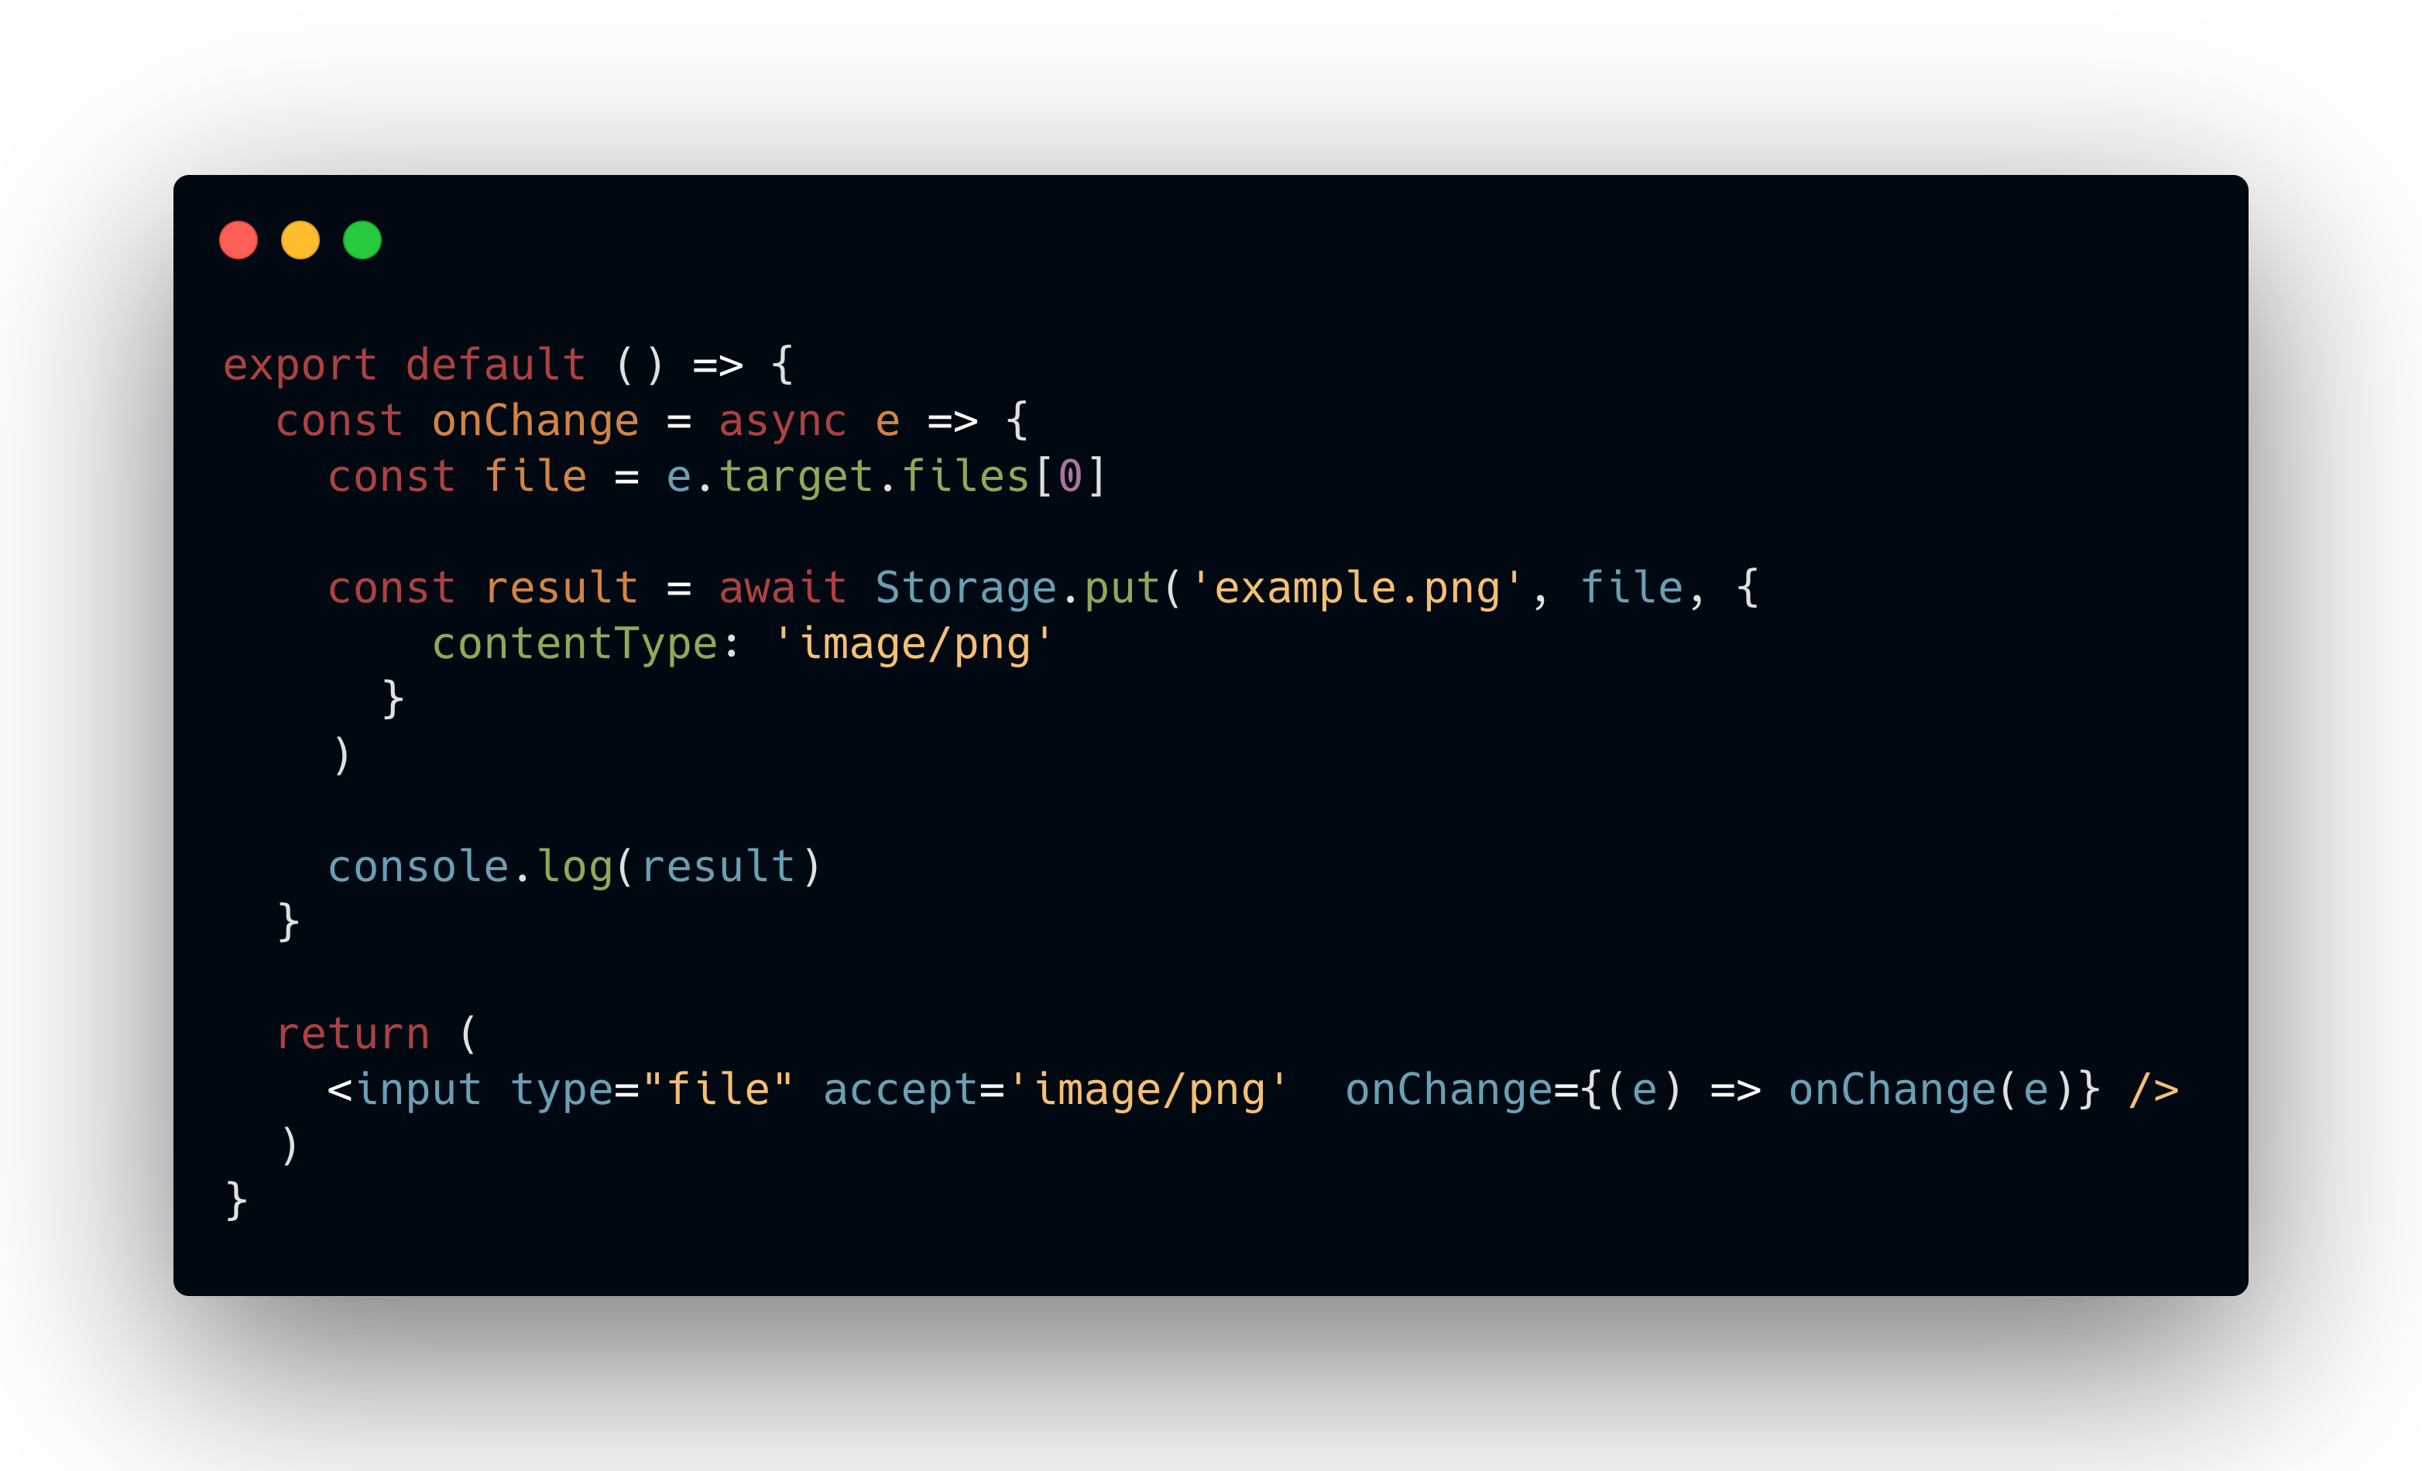
Amplify Client
Uploading a file

Slide 19
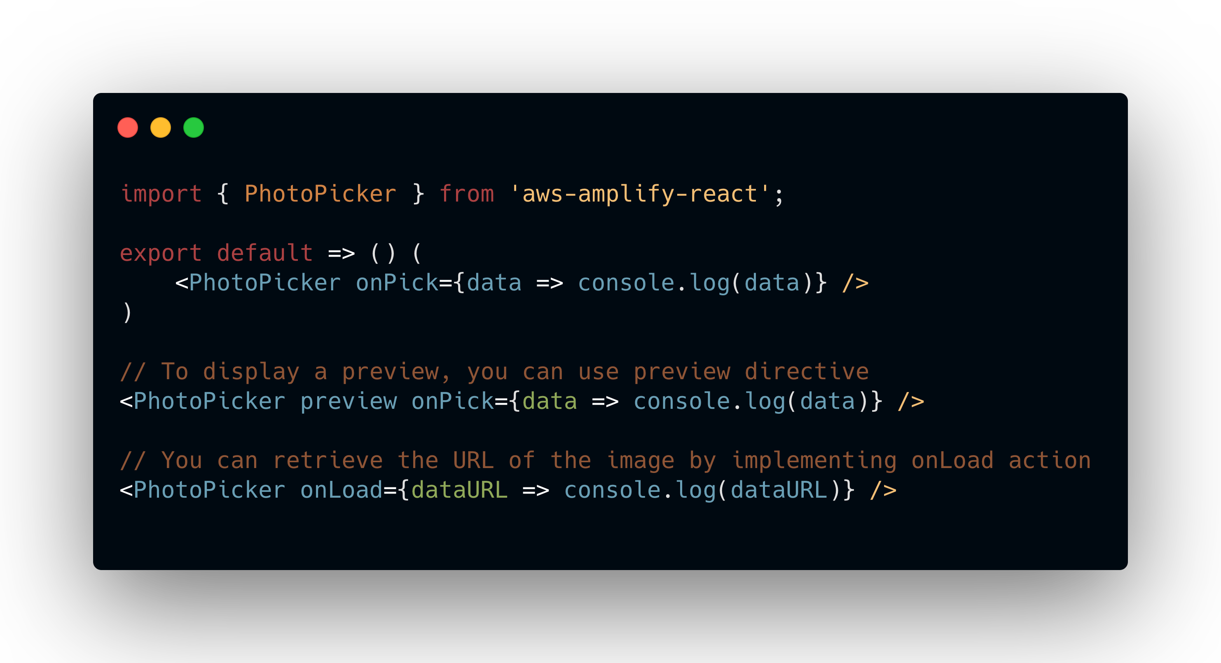
Amplify Client
Photo Picker

Slide 20
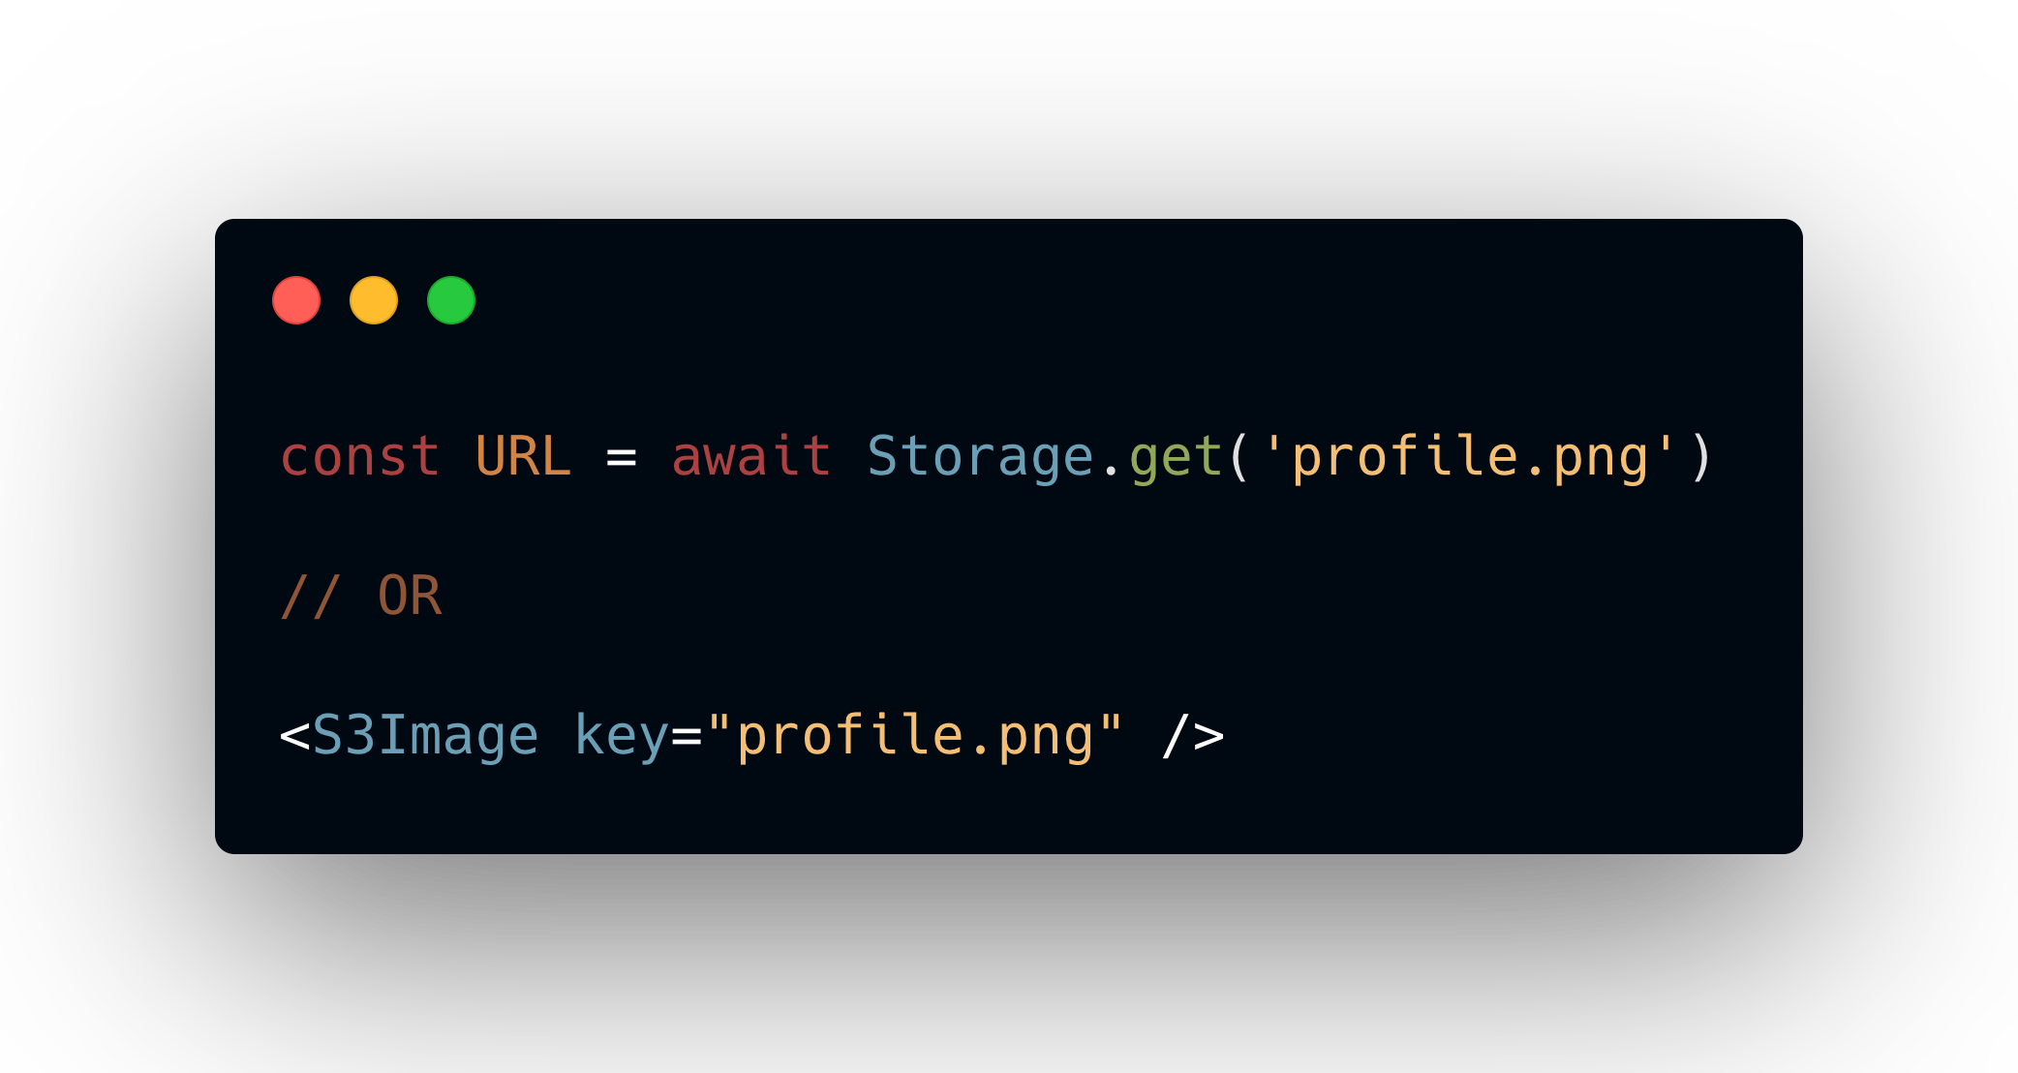
Amplify Client
Fetching a file

Slide 21
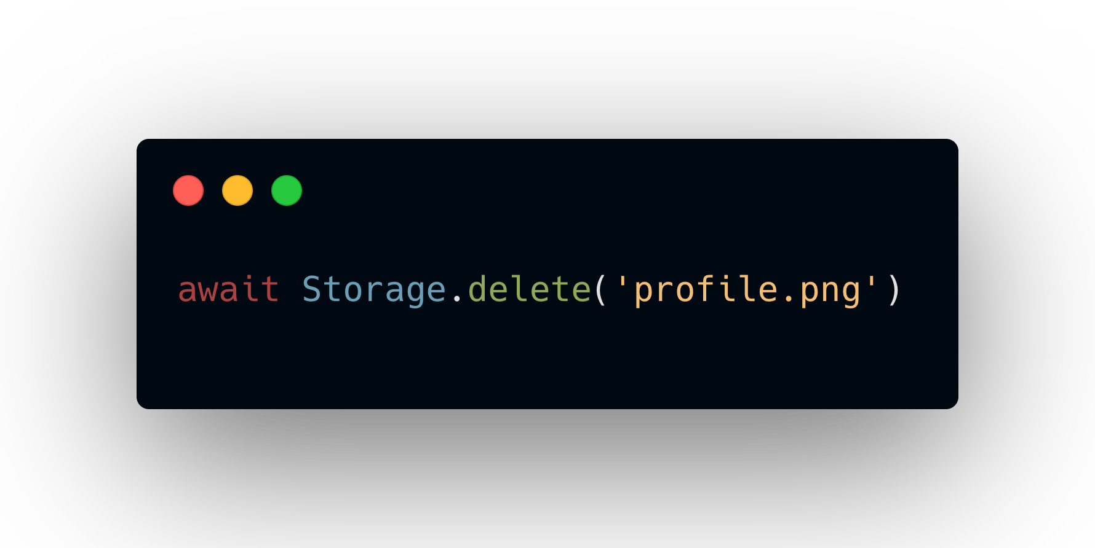
Amplify Client
Deleting a file

Slide 22
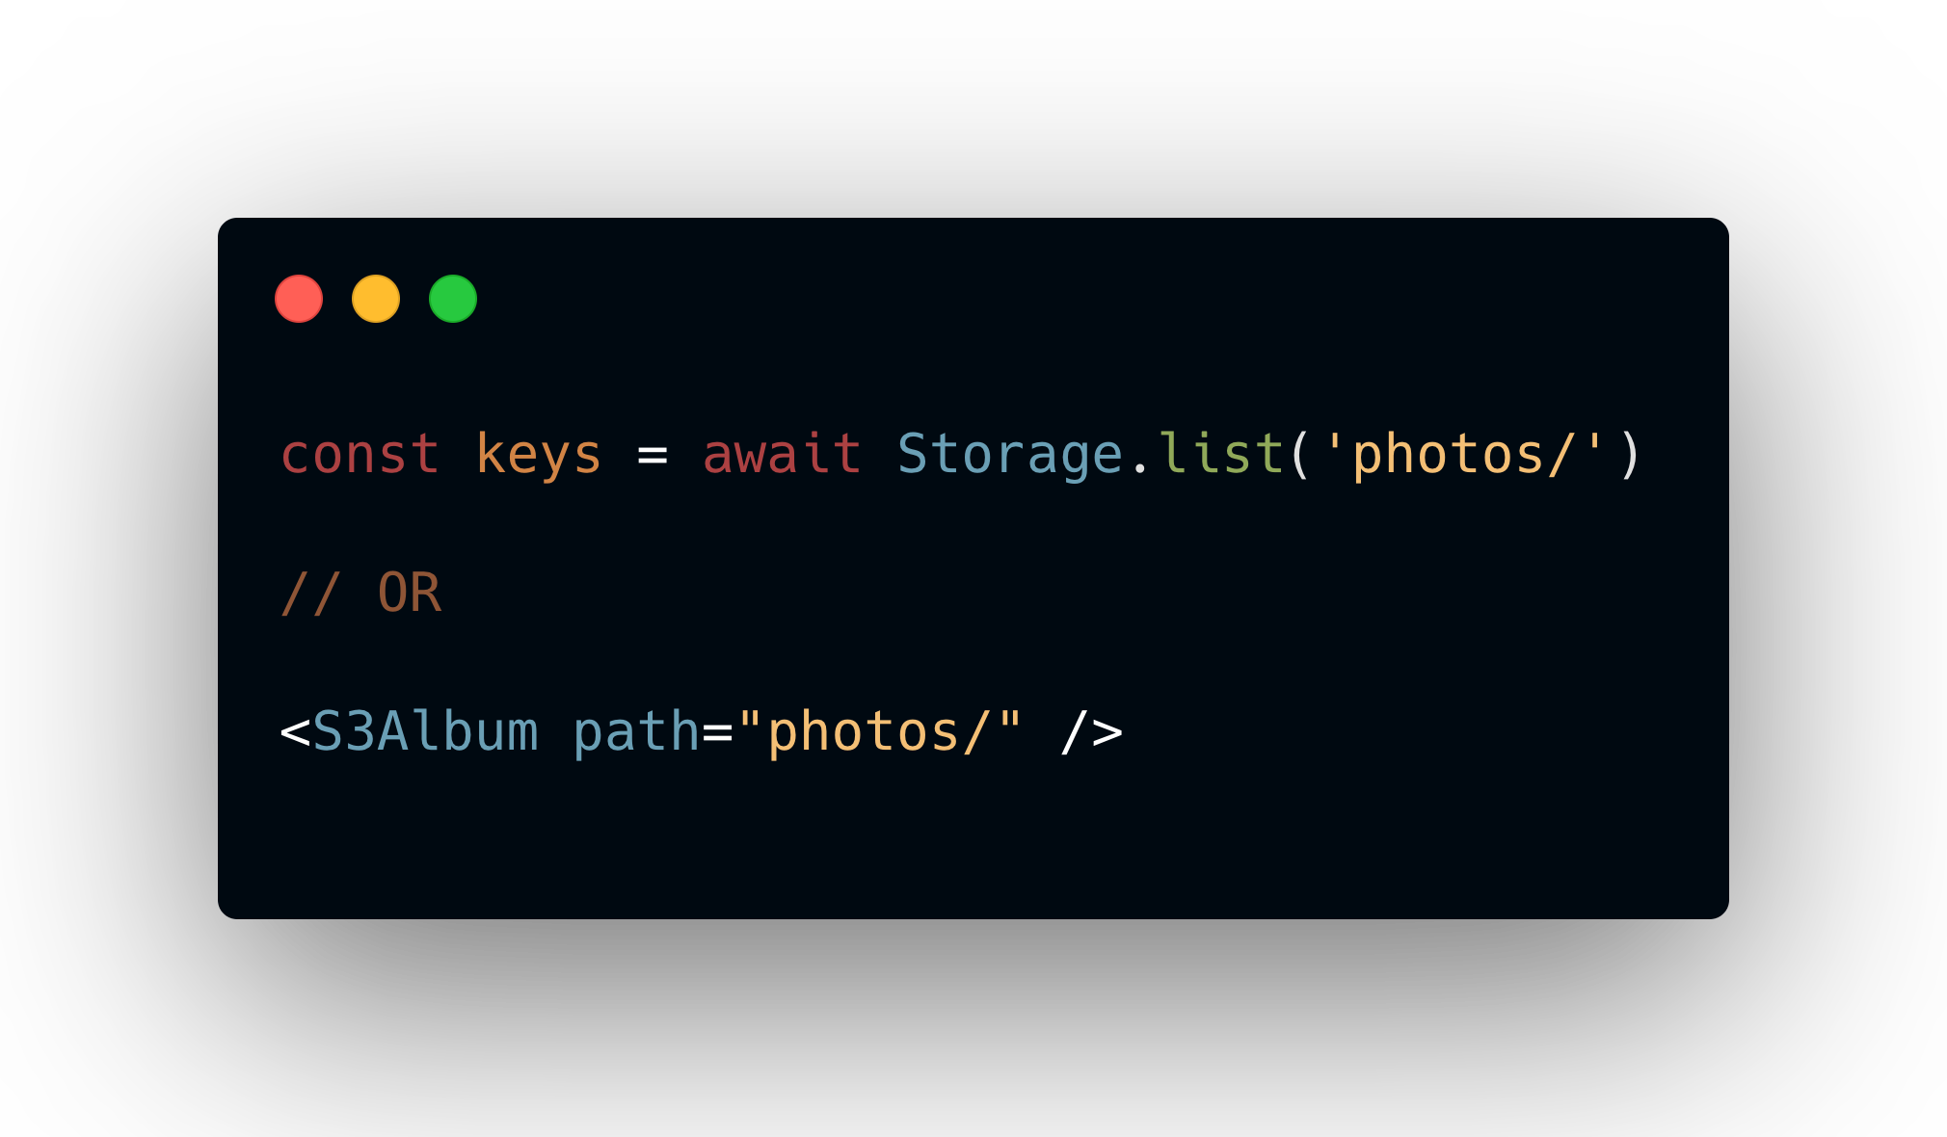
Amplify Client
Listing files

Slide 23
Controlling File Access

Slide 24
Storage
Access Levels
Public - Accessible by all users of your app
Protected - Readable by all users, but writable only by the creating user
Private - Only accessible for the individual user

Slide 25
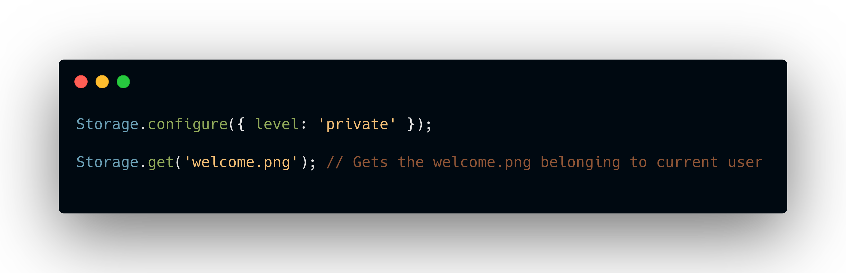
Amplify Client
Setting Global Access Control

Slide 26
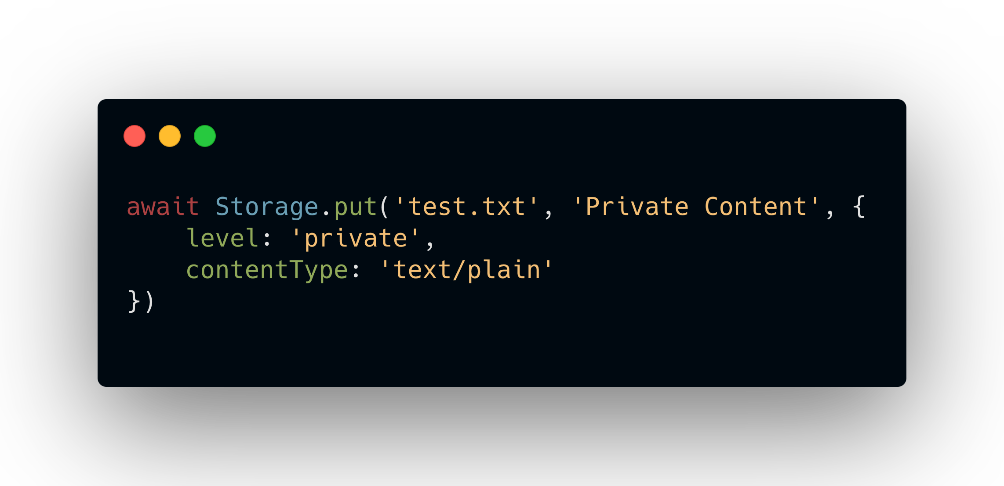
Amplify Client
Setting Access Control Locally

Slide 27
Setting Up Lambda Triggers

Slide 28
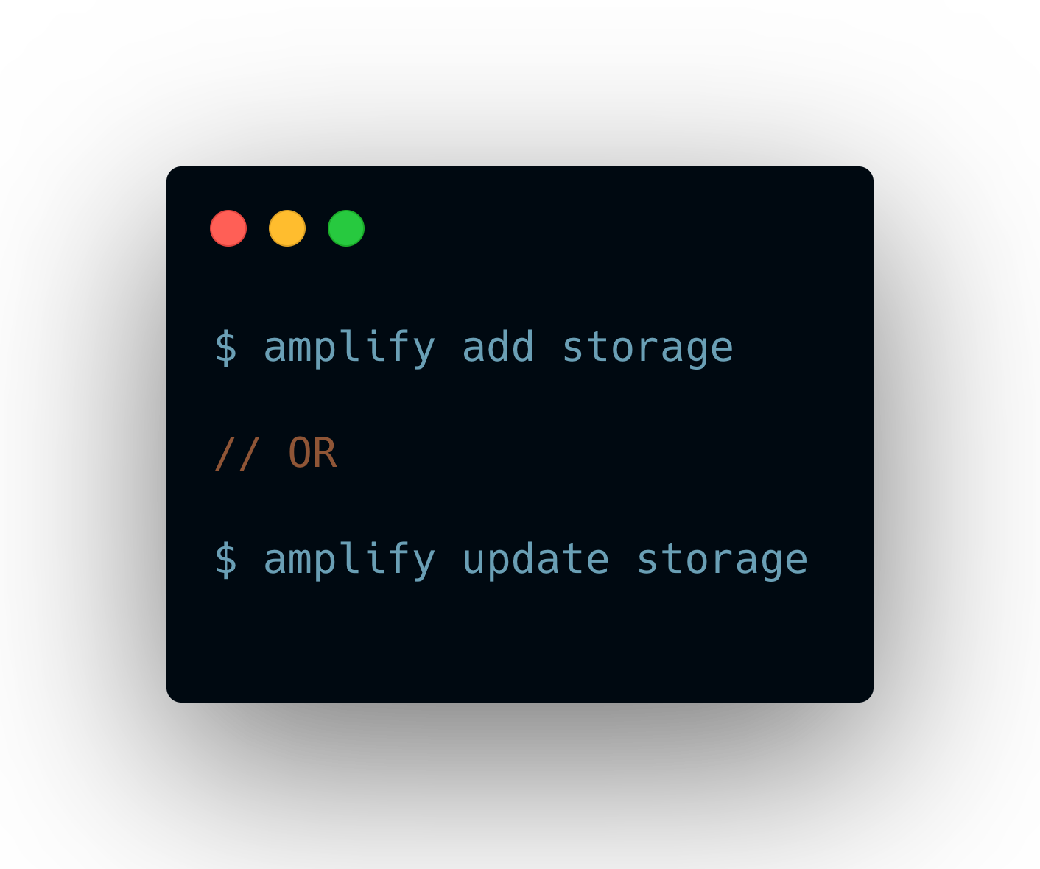
Amplify CLI
Add Lambda Trigger

Slide 29
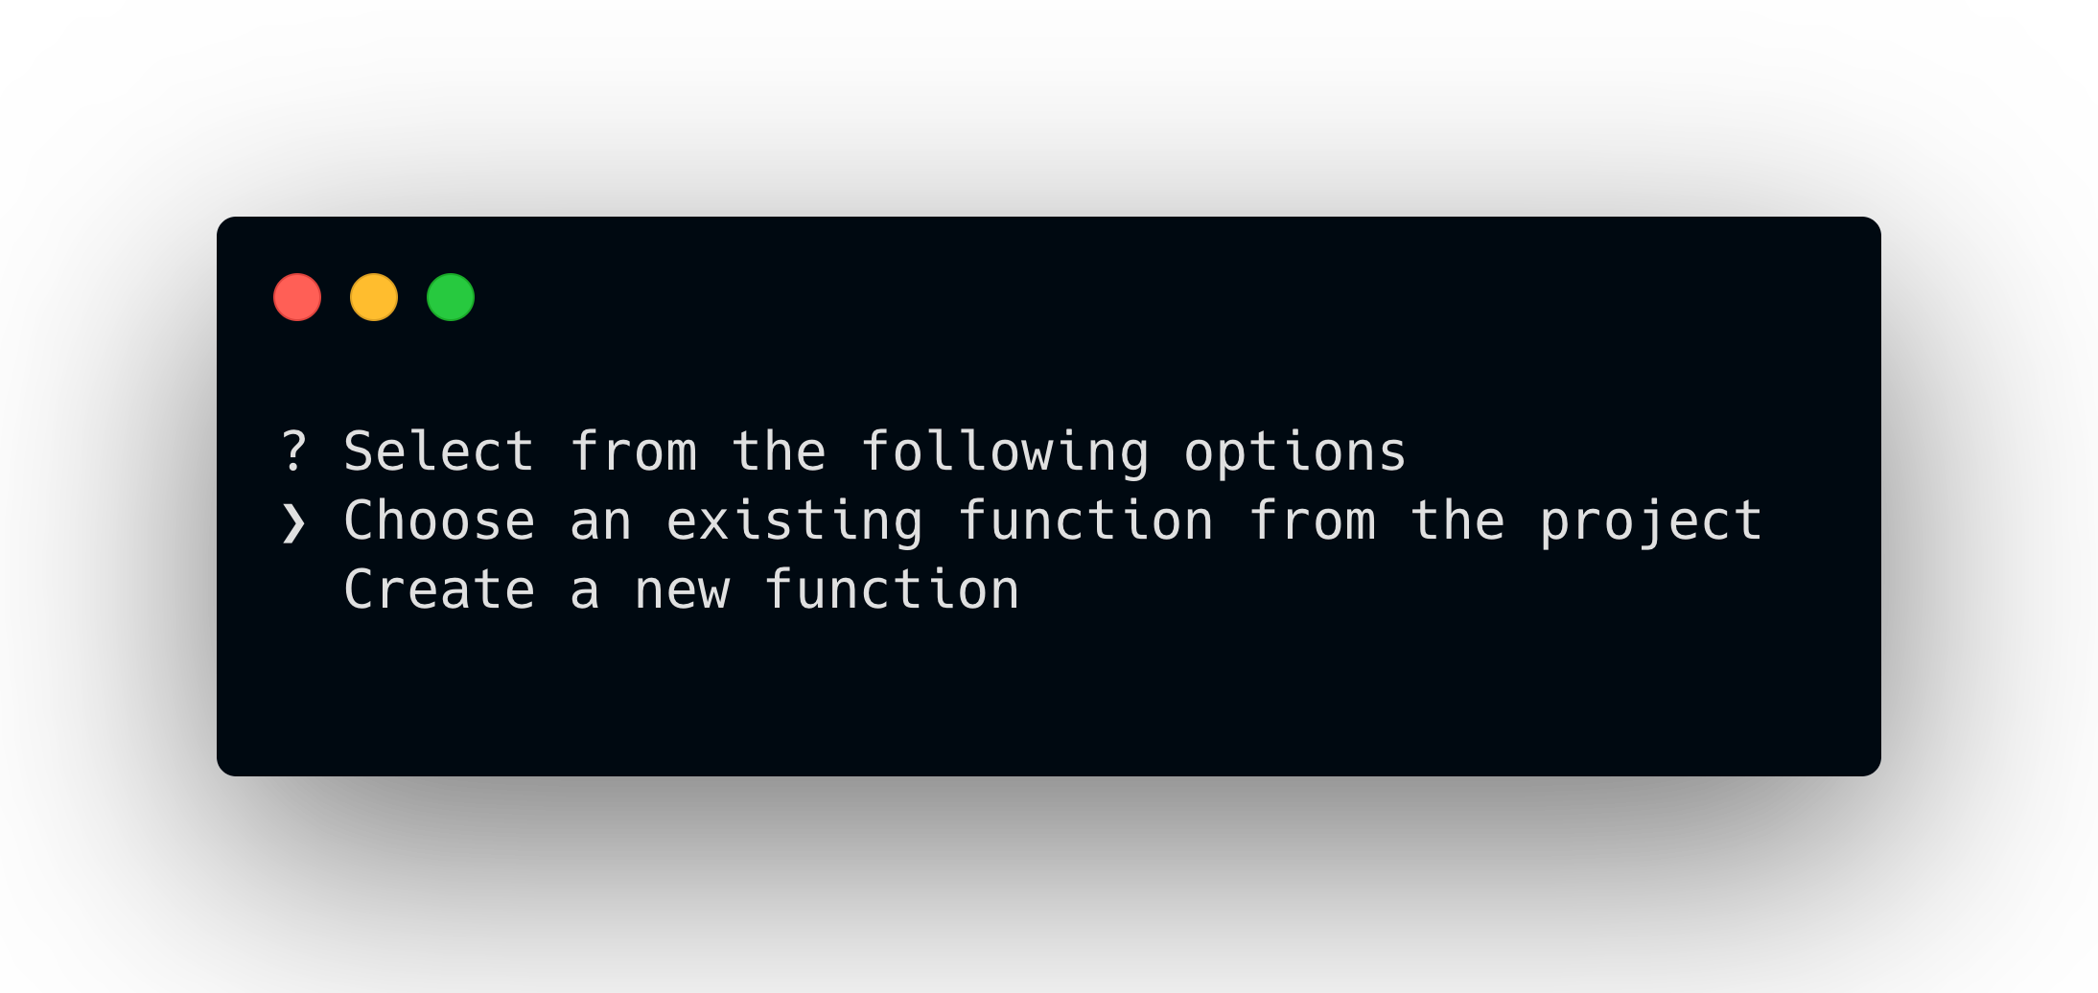
Amplify CLI
Create or Choose a Function

Slide 30
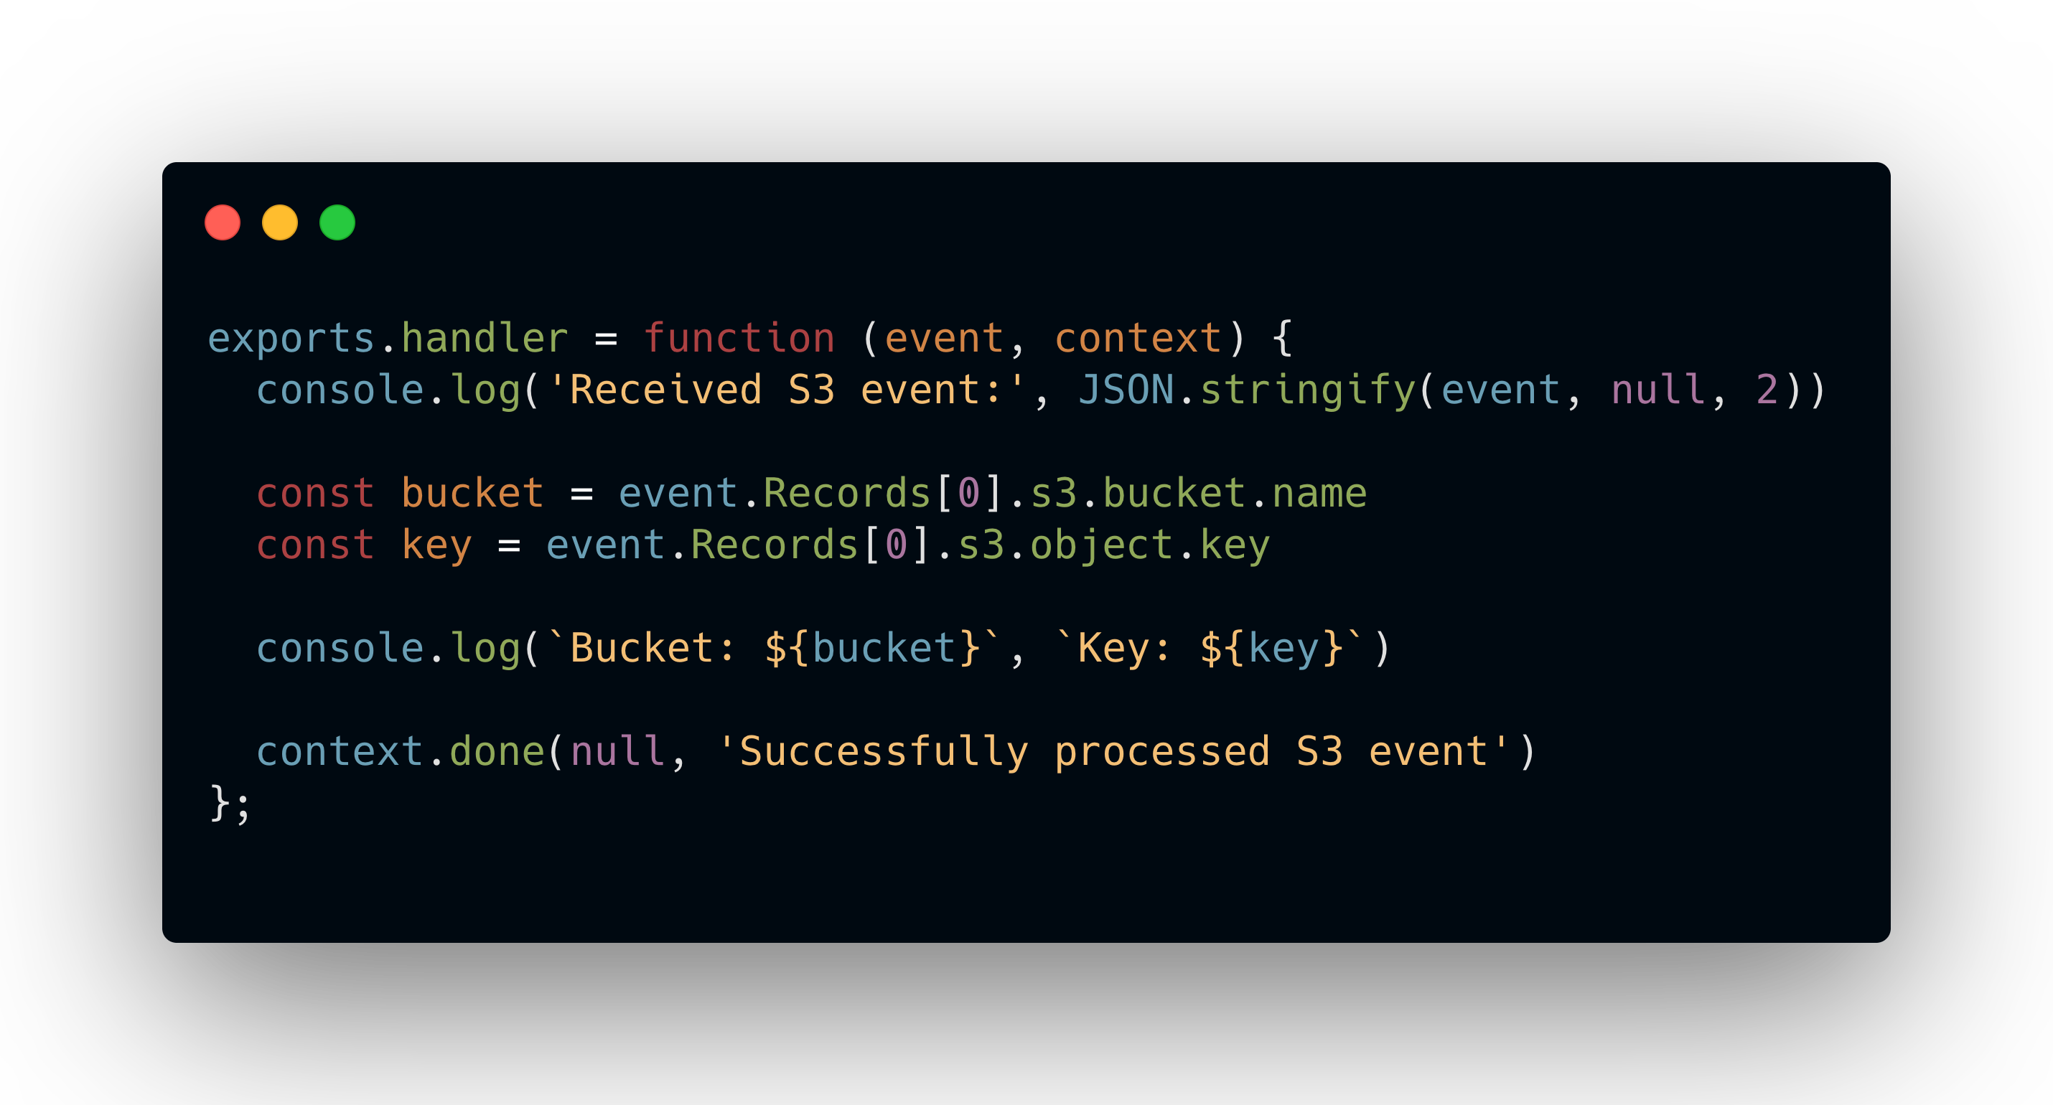
amplify/backend/function/myfunction
Function Example

Slide 31
Demo

Slide 32
Name
Title
@handle

